Slide 1
A very very quick review
Validity and soundness.
Let's look at an example:
If you are a human being you are either a male or a female.
Luhan is not a male, therefore Luhan is a female.
Which are premises? Which is the conclusion?

Slide 2
What about this one?
If you are a male UESTC student, then you don't have a girlfriend.
(name) is male. (name) is a UESTC student.
What conclusion can we draw?
Is this true? What issues can we see here?
Is this argument valid and or sound? Why, why not?

Slide 3
Conditionals and Possibilities
Today we will learn about necessary and sufficient conditionals as well as exclusive and exhaustive possibilities.
First let's cover what is a conditional and then possibilities.
What's a simpler word for necessary?
What about sufficient?
Need
N
E
Enough

Slide 4
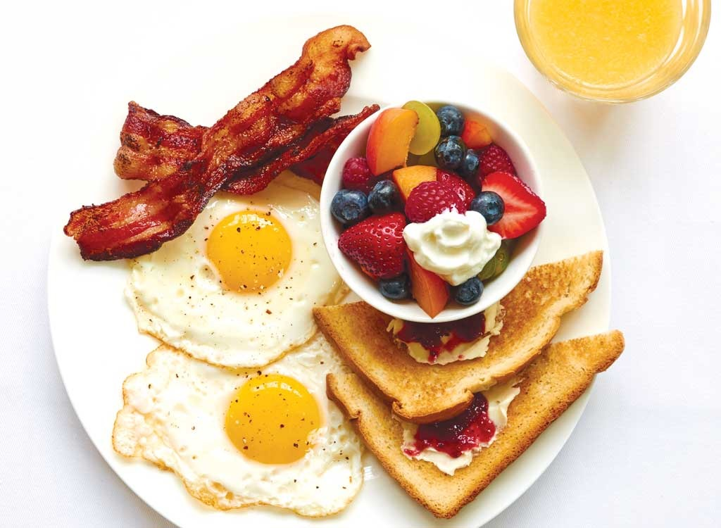
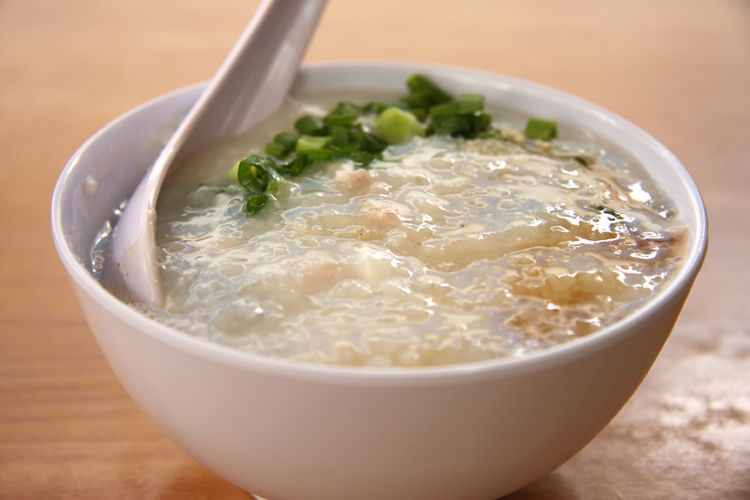
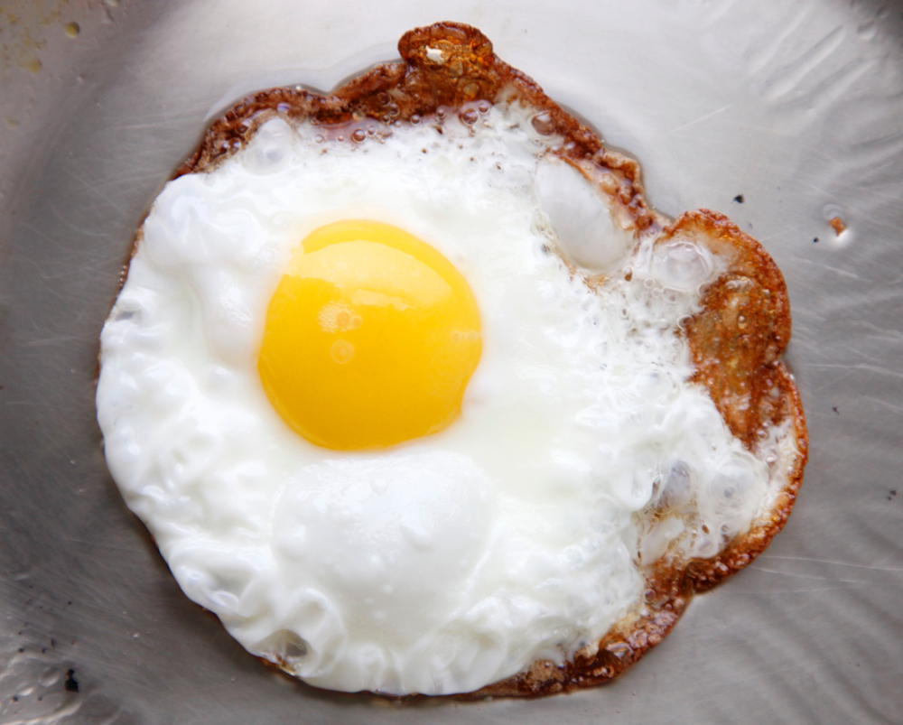
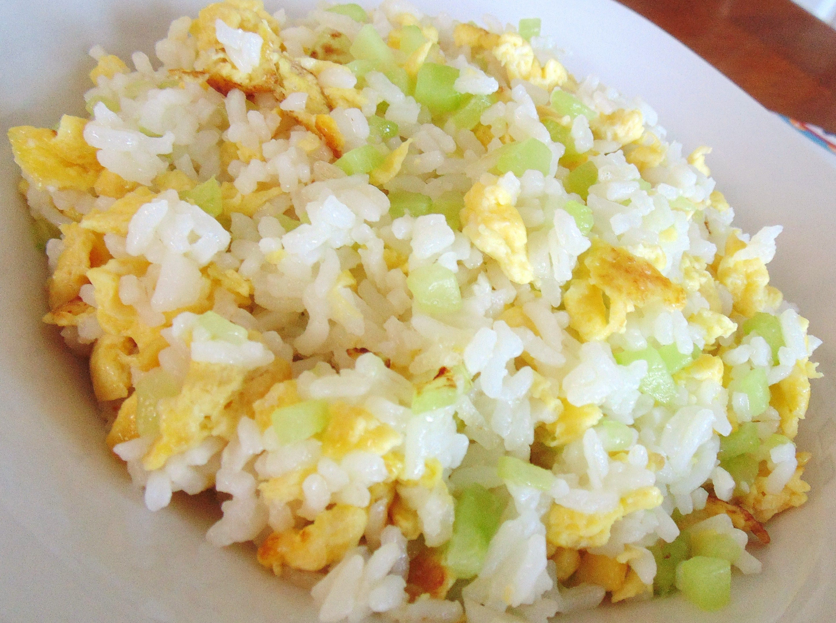
Necessary and Sufficient Conditionals
Porridge
Breakfast
Congee
Egg Fried Rice
Fried Egg

Slide 5
Food Item | Necessary | Sufficient
Fried Egg | ☑ | ☑
Egg Fried Rice | ☑ | ☒
Breakfast | ☒ | ☑
Porridge/Congee | ☒ | ☒

Slide 6
Task 1
The next slide has a table of necessary conditions in one column and it’s matching statement in the second column.
Match the left hand side with the right hand side of the table.
They should be paired together logically.

Slide 7
Column 1 | Column 2
1) Have a rocket ship | A) Being in a thunderstorm
2) Having rain | B) Becoming a football player
3) Being a singer | C) Visiting the moon
4) Having legs | D) Being a father
5) Being a male | E) Winning a Grammy award

Slide 8
To Review
To check for necessary, we need to ask ourselves: Do we NEED this conditional to be true in order to reach a certain “destination” or “conclusion” or “possibility”.
Often there is only one possibility when a conditional is met.
Think of that If x is true, then y will be true as well.
If bridge x exist, then we can reach destination y. Sometimes we can use one bridge to reach multiple destinations, sometimes we need multiple bridges to reach a single destination.

Slide 9
Using Logic to Classify Animals

Slide 10
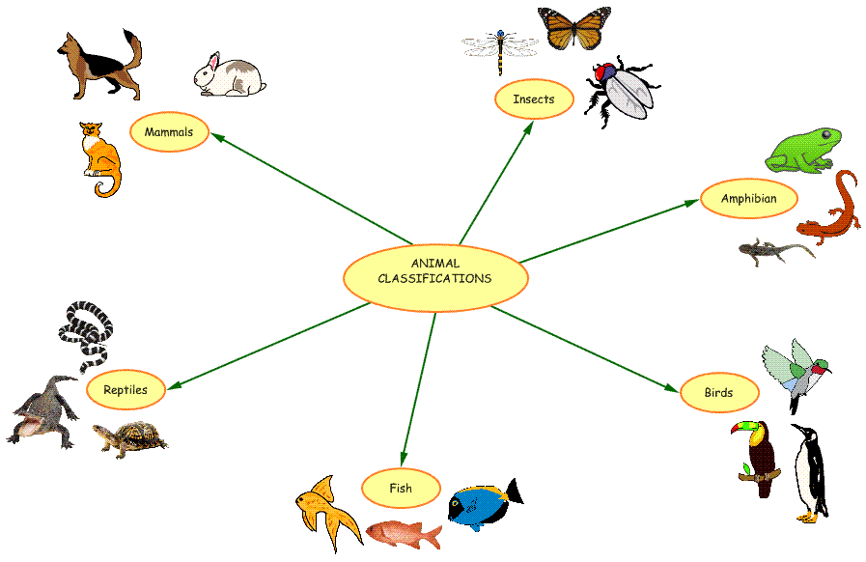

Slide 11
Look at the following Statements
Decide if the statements contain necessary and or sufficient conditions:
There are some exceptions to the rule in real biology but follow the information we have given you
Only mammals have fur. A cow has fur therefore it is a mammal
All fish lay eggs. A gold fish lays eggs therefore it is a fish.
An eel is a fish because it has gills and all fish have gills.
All birds grow feathers, if an animal has feathers then it must be a bird.
All mammals are warm-blooded, only animals that are cold blooded are not mammals.
Some mammals have four legs. My pet has four legs therefore it is a mammal.
Notes:
1.N+S
2.N+!S
3.N+!S
4.N+S
5.N+!S
6.!N+S

Slide 12
Look at the following Statements
Decide if the possibility of the statements are exclusive and or exhaustive:
If an animal lays eggs it’s a bird or a reptile.
If an animal is a (normal and healthy) mammal it will have no legs, four legs or two legs.
A bird must have either a bill or a beak.
Not cold-blooded animals are birds.
Cold blooded animals have scales or skin.
Notes:
1)!EC !EH
2) EC !EH
3)EC EH
4)!EC EH
5)EC !EH

